Slide 1

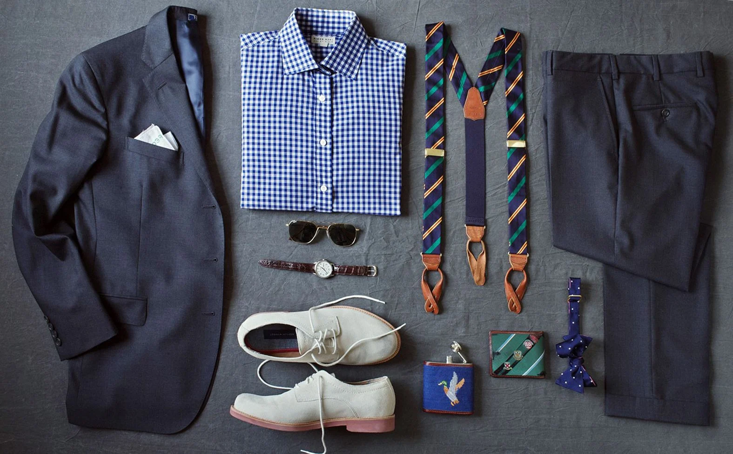
AI BASED Virtual clothing try on
“Machine Intelligence is the last invention that humanity will ever need to make”
-Nick Bostrom

Slide 2


Problem statement
From the consumer and brand point of view, digital fashion is a big hit. This is because consumers can try it on before actually buying the item.
Soon customers will shop for clothes online by clicking on a fashion item and uploading a picture of themselves. The site will send you back the picture with you wearing the clothing item. This will ultimately lead to digitalization retail industry.
Therefore, it is important for brands to have a virtual fashion library. This saves brands time, money, while also being innovative. As we can see digitalization of retail industry to grow more and more soon.

Slide 3
SOLUTION Road Map
Try On
Semantic Segmentation
Model
Accuracy
Extended Business View
Constraints
Business View
Try Some cloths

Slide 4

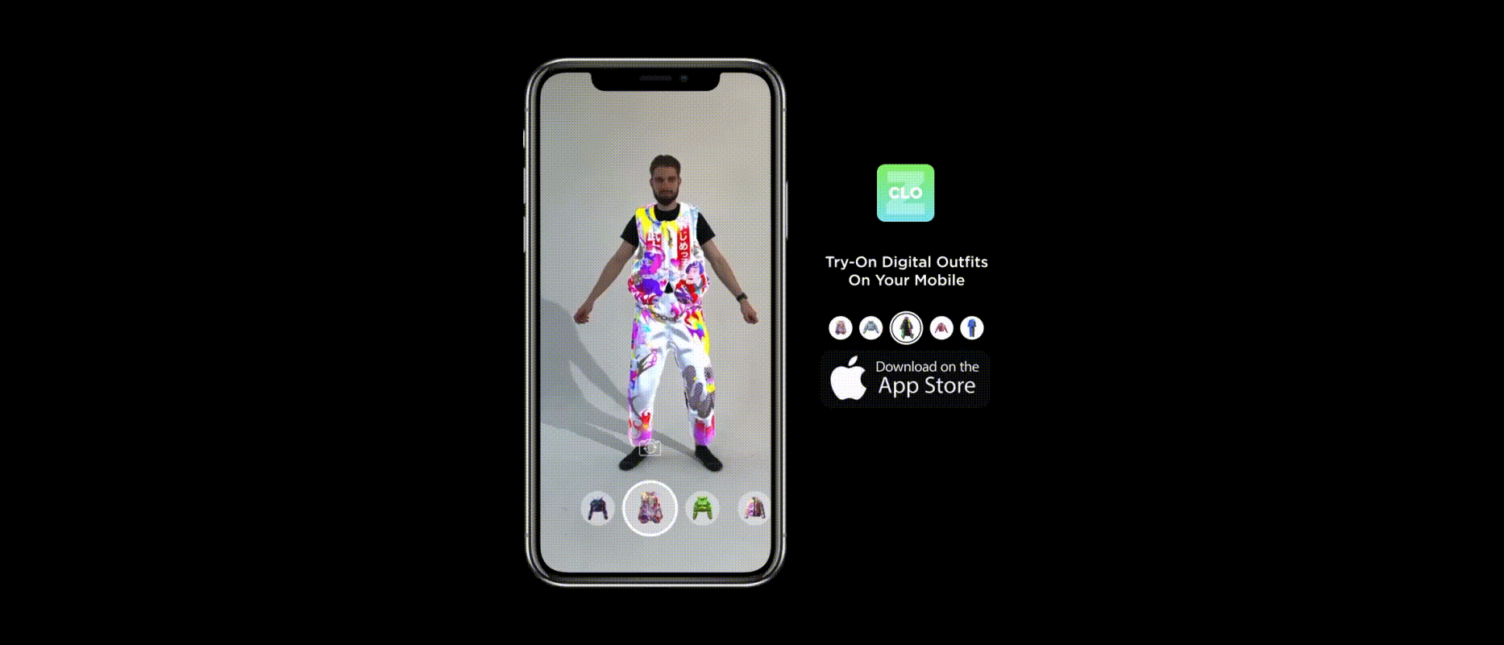
What is TRY ON ??
The Deep Learning Techniques enables consumers to try on garments for size, fit, and style without physically wearing the product.
As a camera-equipped device captures the customer, underlying AR technology maps a realistic virtual representation of the product over their real-world image to show how the product would look on the customer’s body.

Slide 5
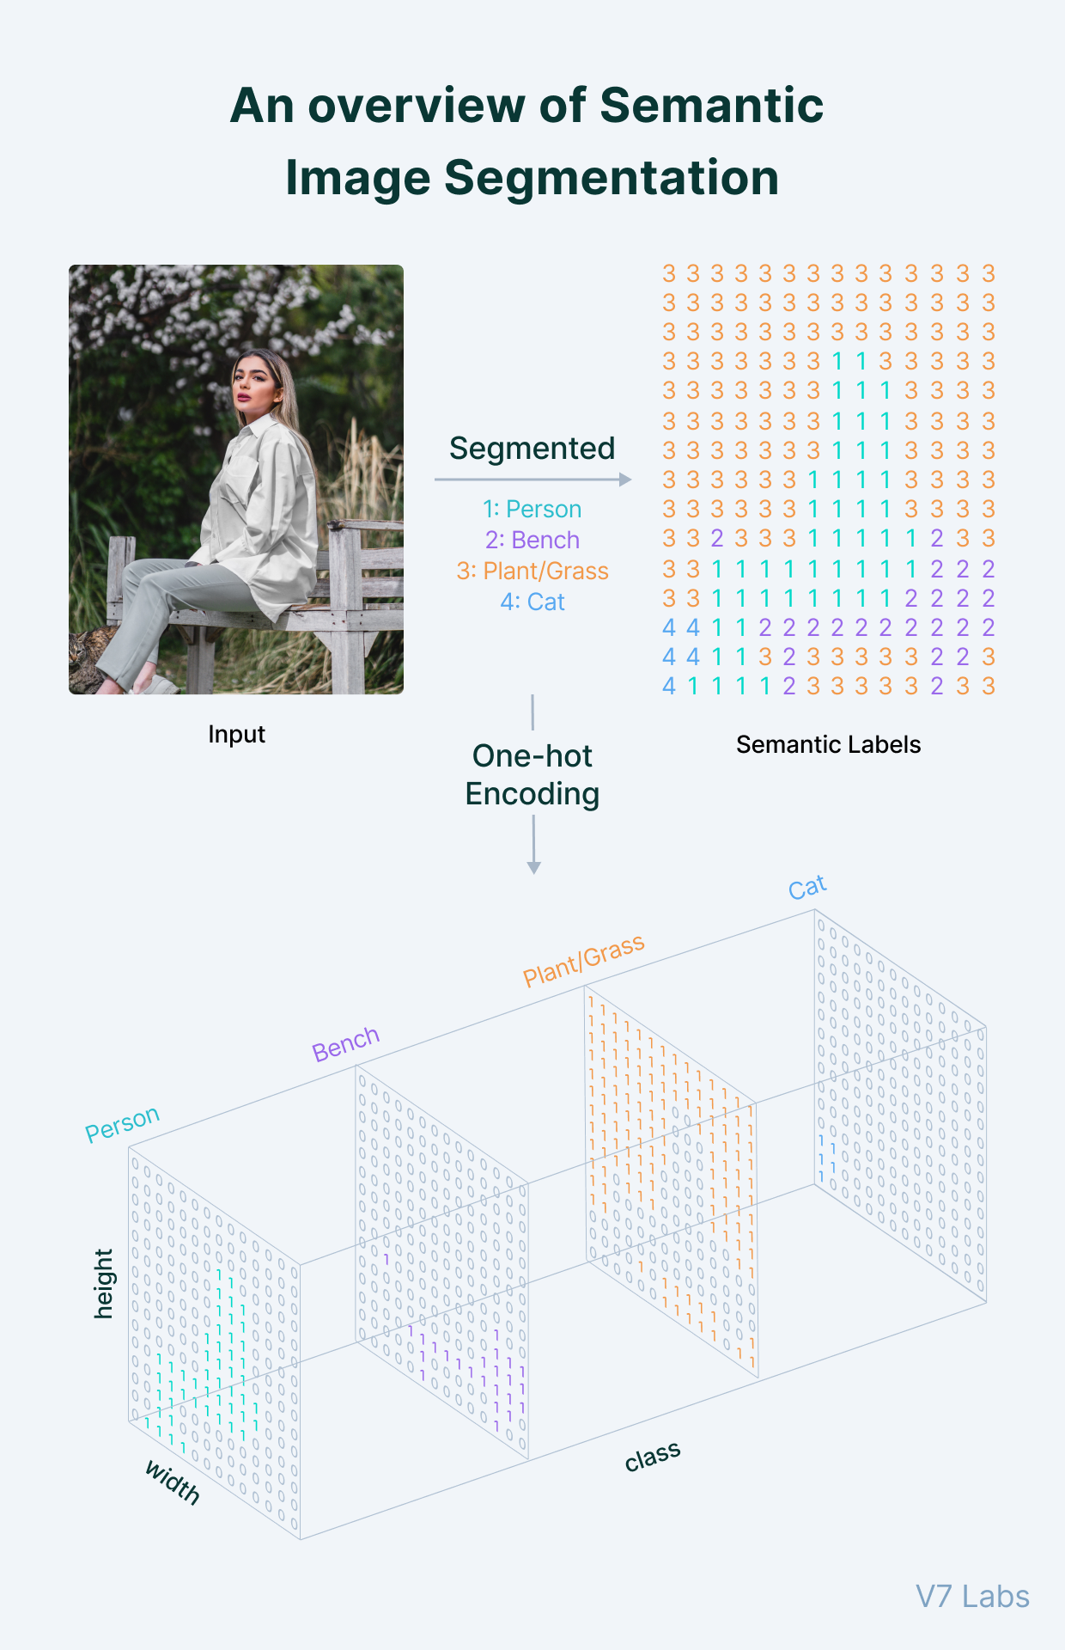

Semantic segmentation
Semantic Segmentation is the task of assigning a class label to every pixel in the image.
It can be considered an image classification task at a pixel level.
These algorithms primarily use convolutional neural networks and their modified variants to get as accurate results as possible.

Slide 6
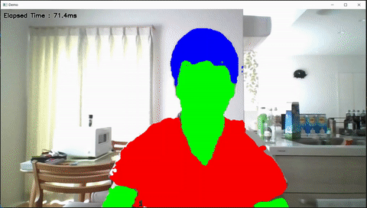
Semantic segmentation
U-Net is an architecture for semantic segmentation. It consists of a contracting path and an expansive path. The contracting path follows the typical architecture of a convolutional network.
U-net uses a loss function for each pixel of the image. This helps in easy identification of individual cells within the segmentation map. SoftMax is applied to each pixel followed by a loss function.

Slide 7

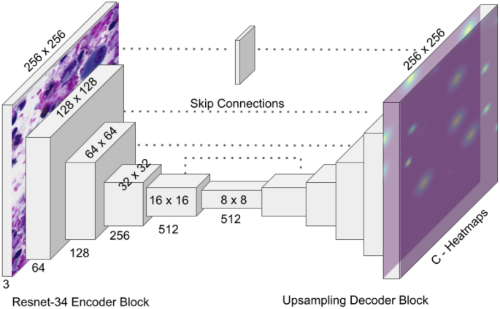
MODEL
Dataset:
The dataset contains 13.5k images along with their respective masks.
There are 8 classes in an image labelled from 0-7 with class names as top, bottom, skin, hair, hat, face, background and garments.
Model:
The model is able to classify each pixel of image into one of the eight classes.

Slide 8
MODEL
What we did :
Import the dependencies.
Clean the dataset.
Prepare data generator.
Define a U-Net Architecture.
Train and validate the model.
Predict the mask for given input.
Specify the class and do try on .

Slide 9
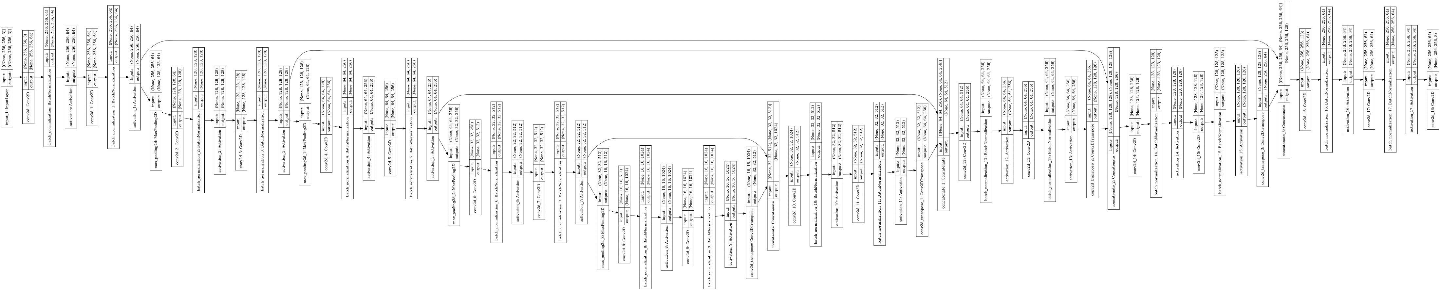
Architecture of our u-net model

Slide 10
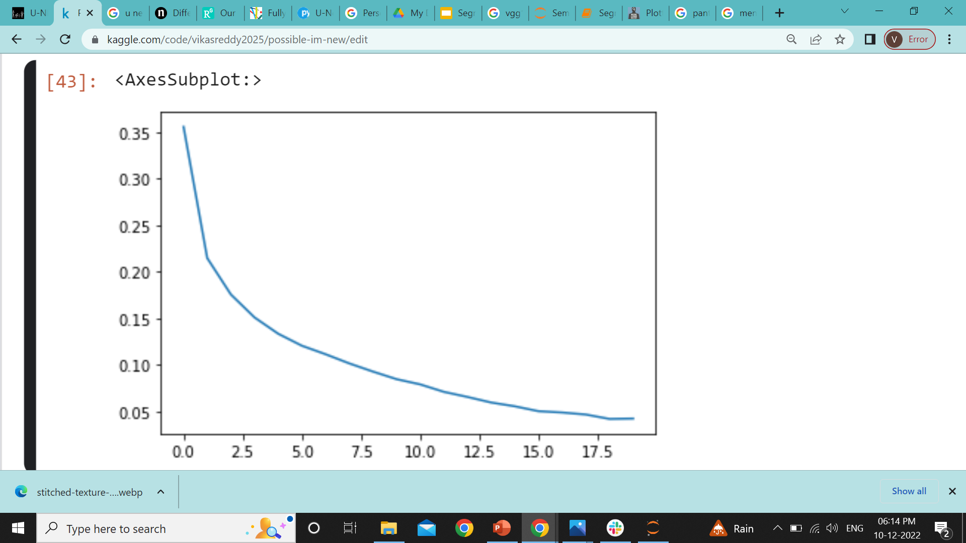
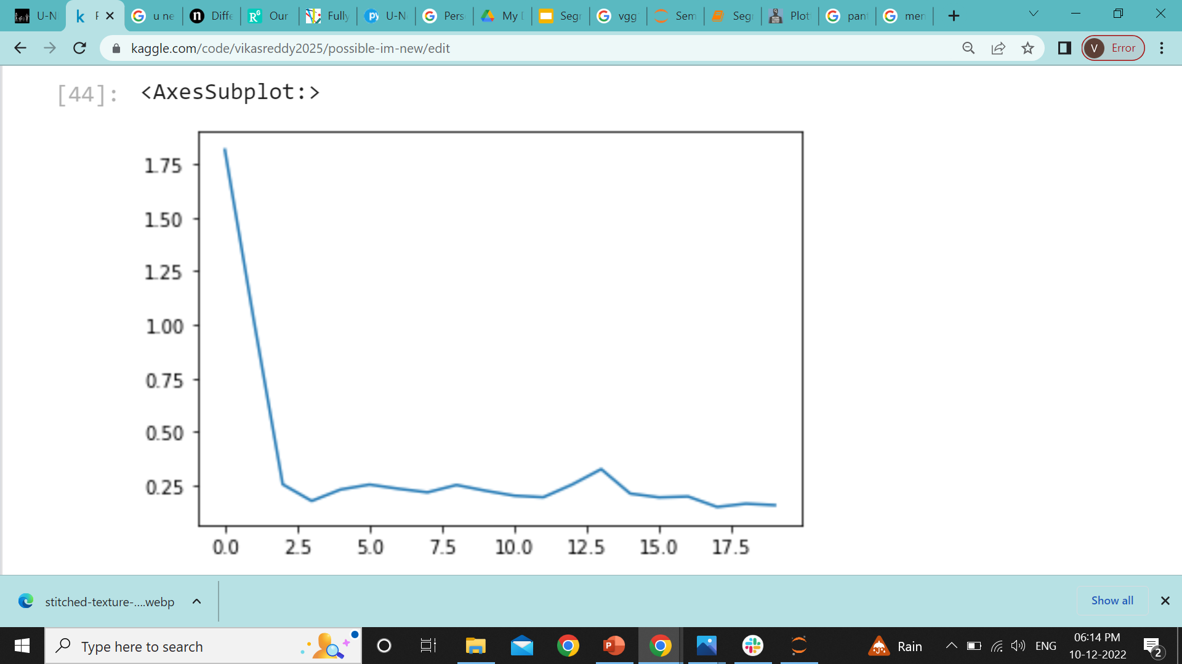
About the model
Training loss Vs Epochs
The model has 18 convolutional layers 8 pooling layers .
The model is trained with 80% of the data and validation split is 20%.
The loss functions used are Sparse_categorical_crossentopy and IOU loss (Intersection Over Union).
The input shape of the images are (256,256,3) and the output shape is (256,256,8),Where 8 in output shape represents the number of classes in the image.
Validation loss Vs Epochs

Slide 11

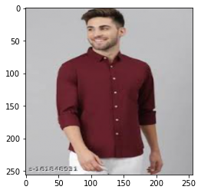
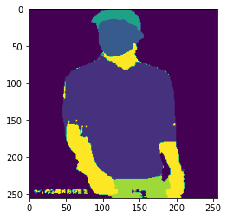
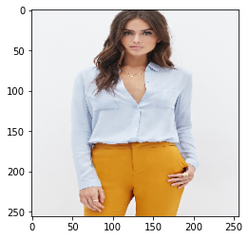
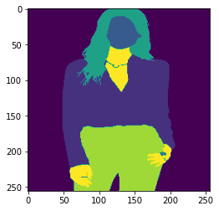
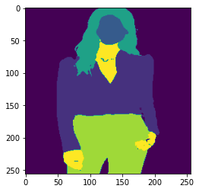
ACCURACY
The model is trained for 30 epochs.
The model achieved more than 80% IOU score for most of the classes both for training and validation dataset.
Not in dataset
Not in dataset
Predicted Mask
Image
Predicted Mask
Image
Image
True Mask
Predicted Mask

Slide 12

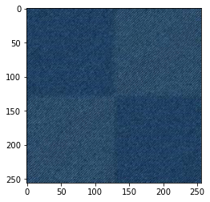
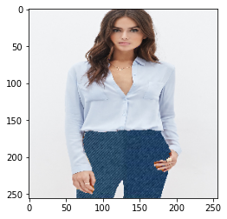
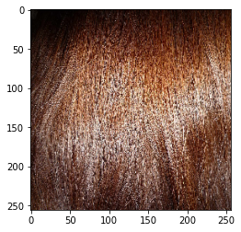
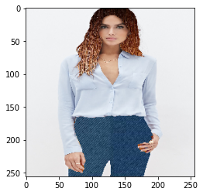
Let's try some cloths
Let's Try this for pant
Let's Try this Hair Color

Slide 13

Business view
Virtual try-on technology has huge potential. It allows brands to personalize the user experience and better meet the expectations of their customers.
By letting customers try on products from the comfort of their home, brands can grow their sales and significantly decrease their return rates.
Potential Clients :
Newly established retail startups ( Features like this gives them better chance to compete with the top brands).
Retail cloth merchants and cloth brands like Macy’s, Disney, Ajio ,etc.

Slide 14

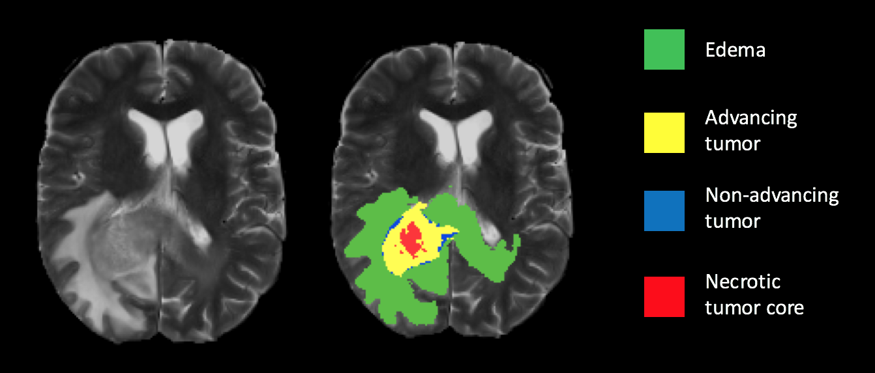
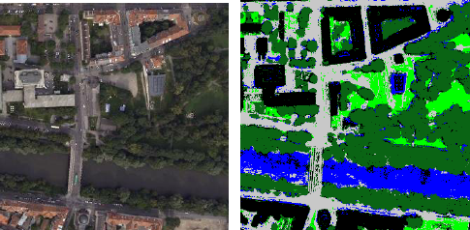
EXTENDED BUSSINES VIEW
Medical :
Detection and localization of tumor in medical images.
Disease grading.
Technology :
Image segmentation for computer vision applications.
Segmentation and detection of roads in aerial image.

Slide 15

Constraints we faced
Dataset
Computational resources
Cost of Computation
Improvements Needed:
1.Trian model for more diverse data.
2.Find faster computational Resources for cheaper cost.
3.Need bigger dataset.

Slide 16
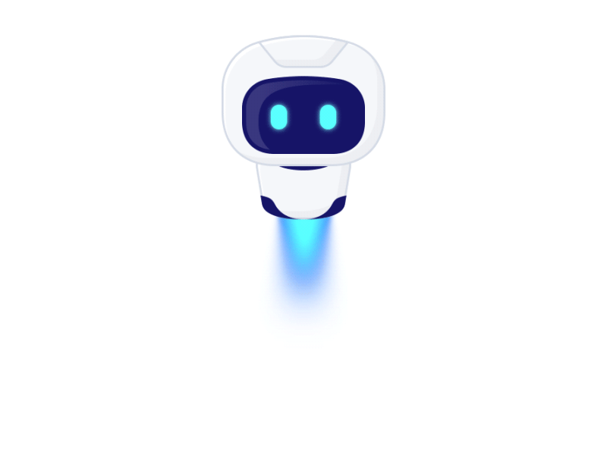
Thank You
By :
Team : Possible-I’m
Vikas Reddy
Chaitanya
Sathya
Mahesh

